Slide 1

Mapping color-redshift relation in COSMOS data to improve redshift calibration strategies for Euclid and LSST surveys based on their expected bands
BIST Master of Multidisciplinary Research in Experimental Sciences - Minor Project
Anastasia Sukhorukova, Carles Sánchez 17.03.2025

Slide 2
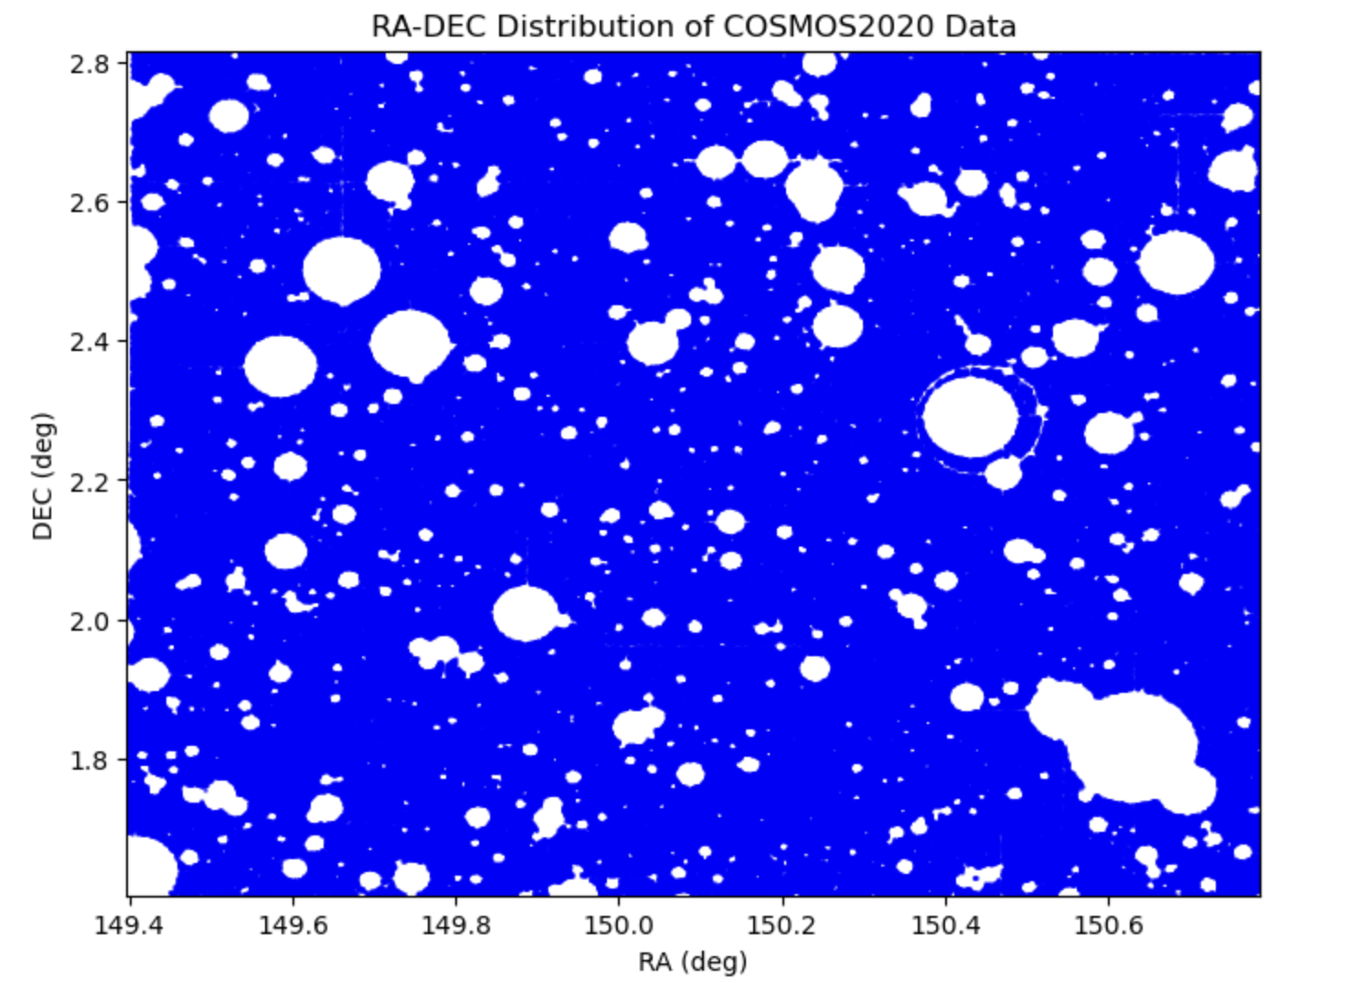
COSMOS2020 - Mask

Slide 3
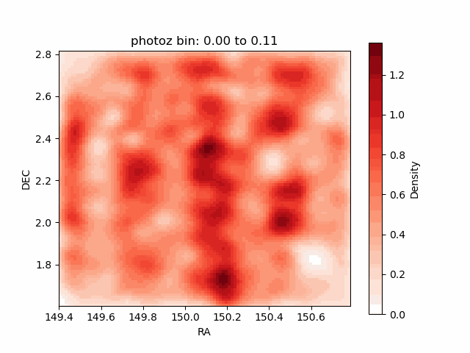
COSMOS2020 Redshift - Density

Slide 4
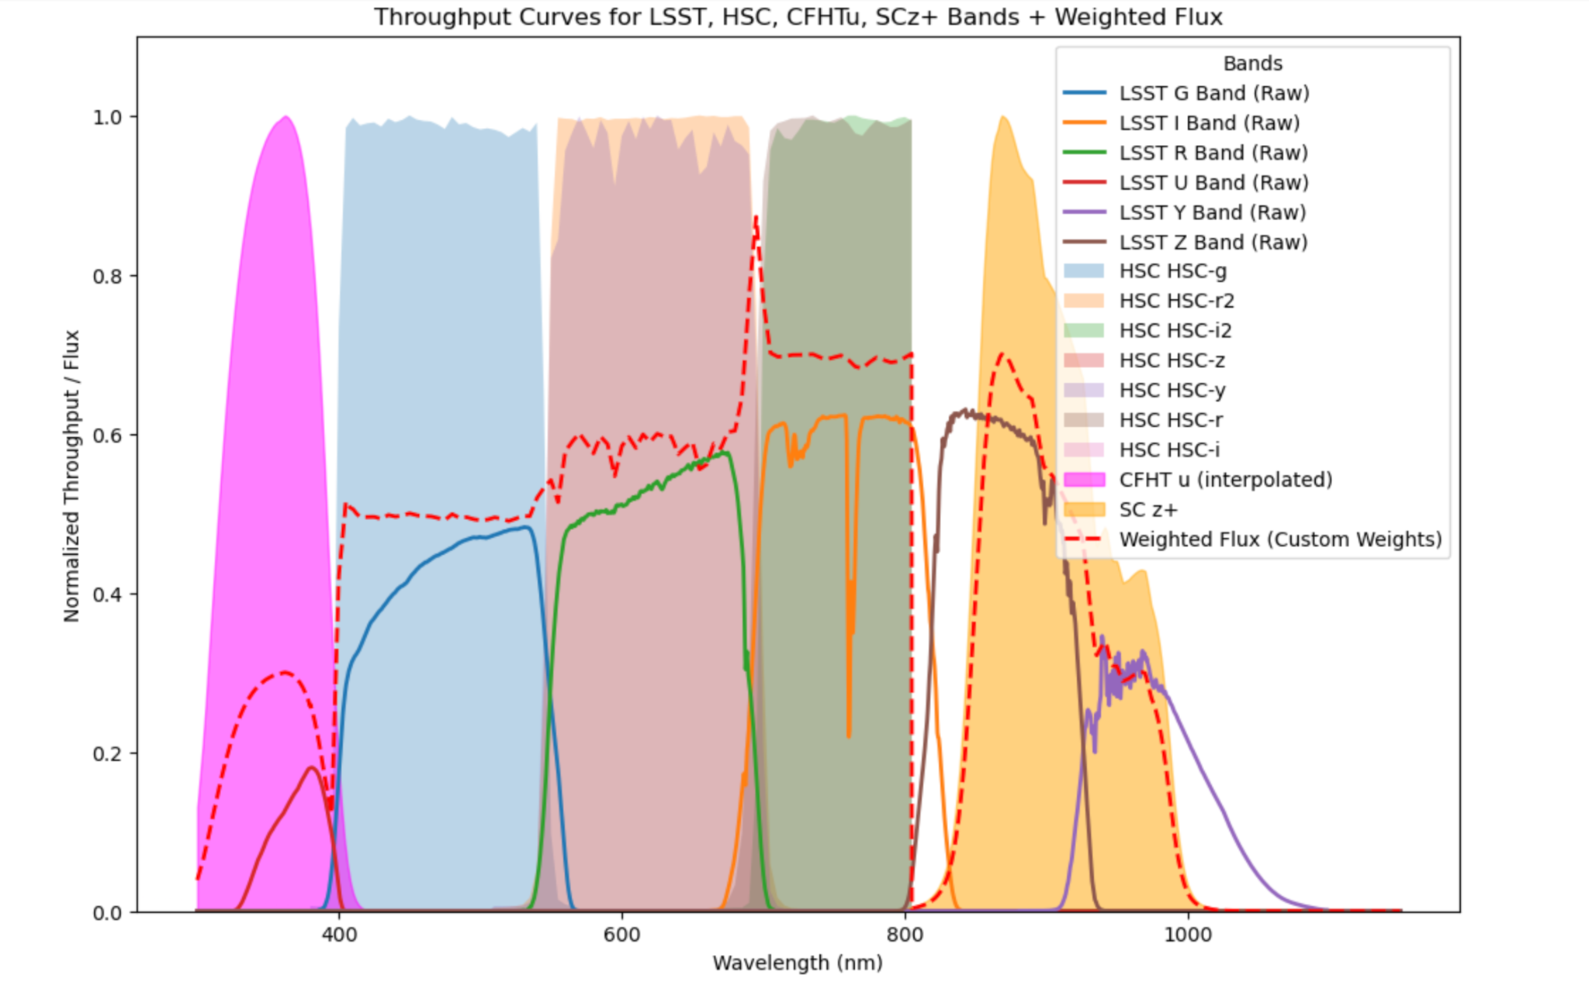
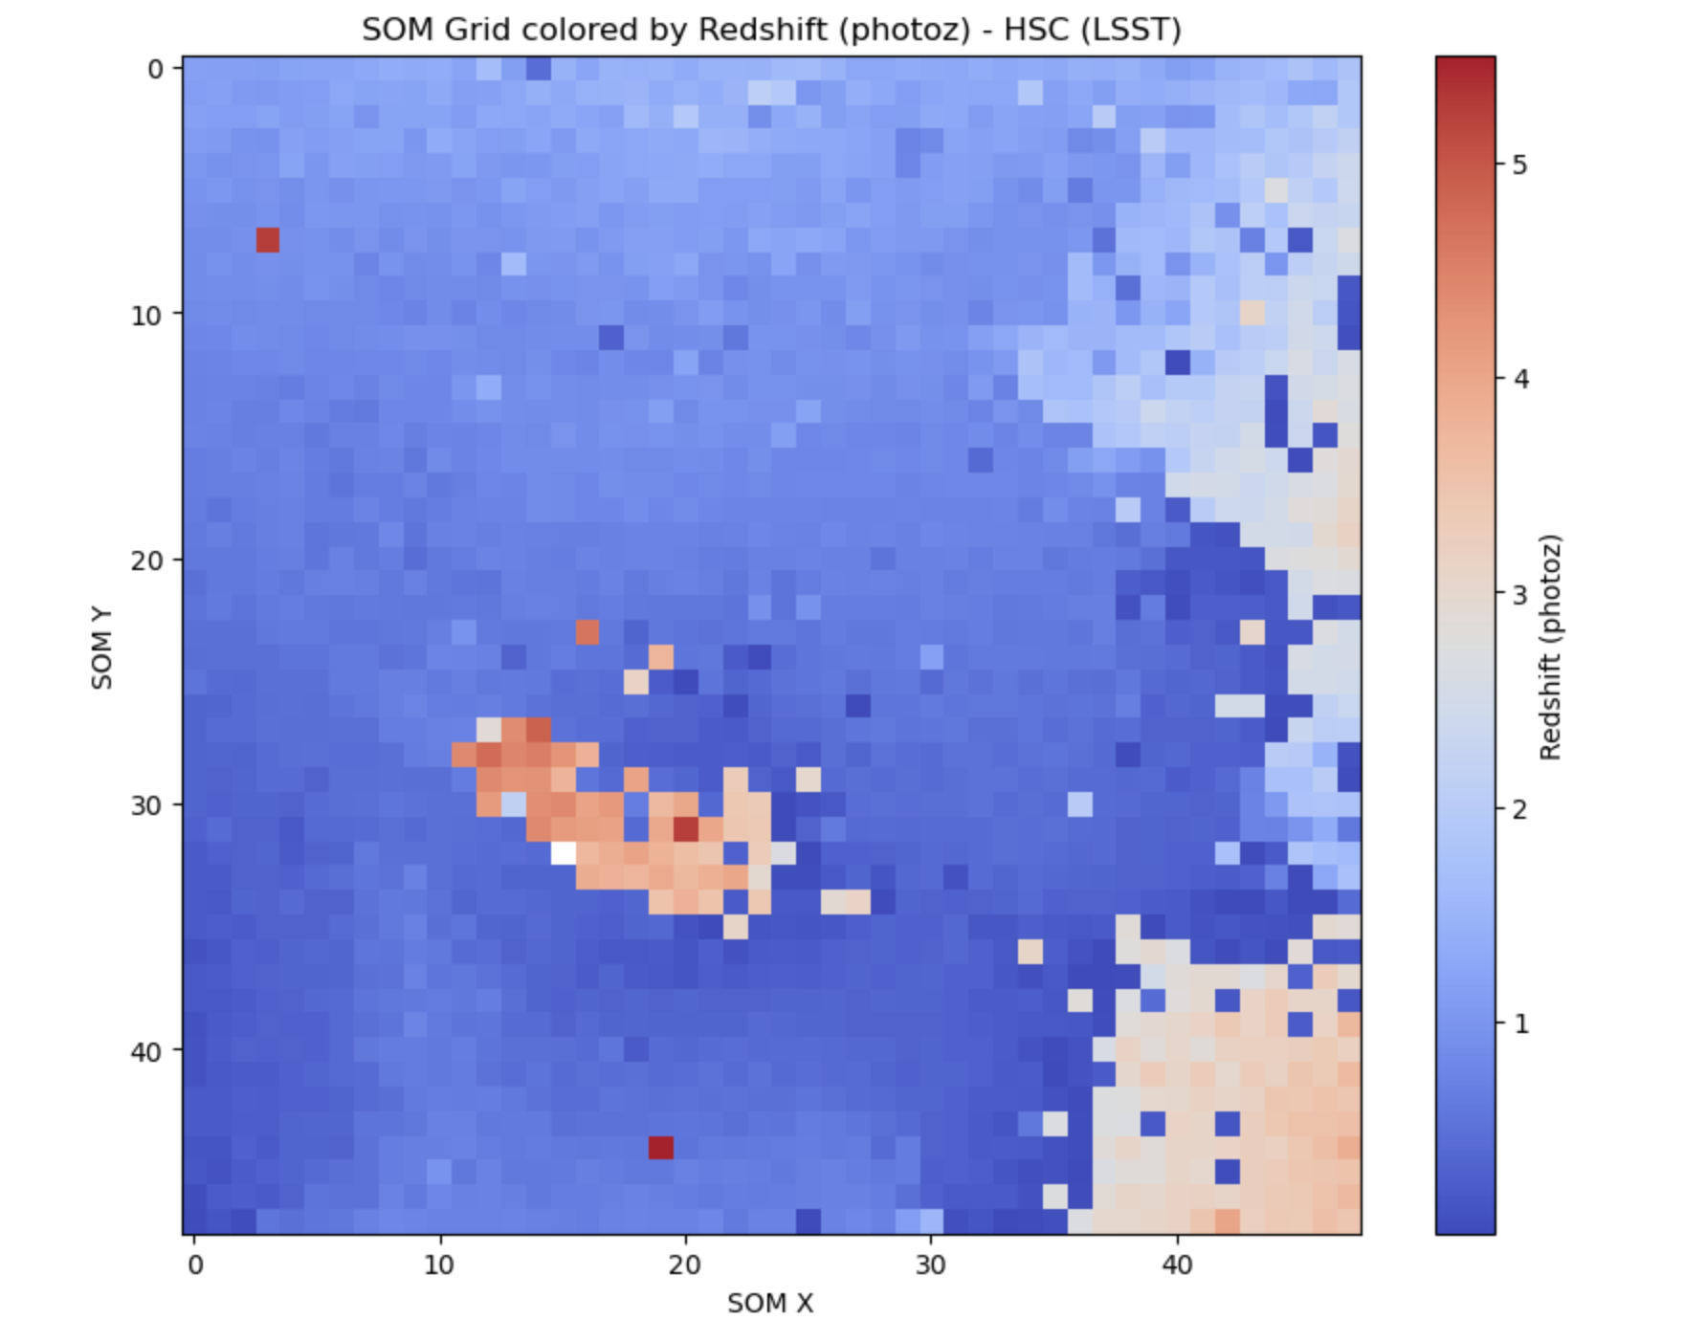
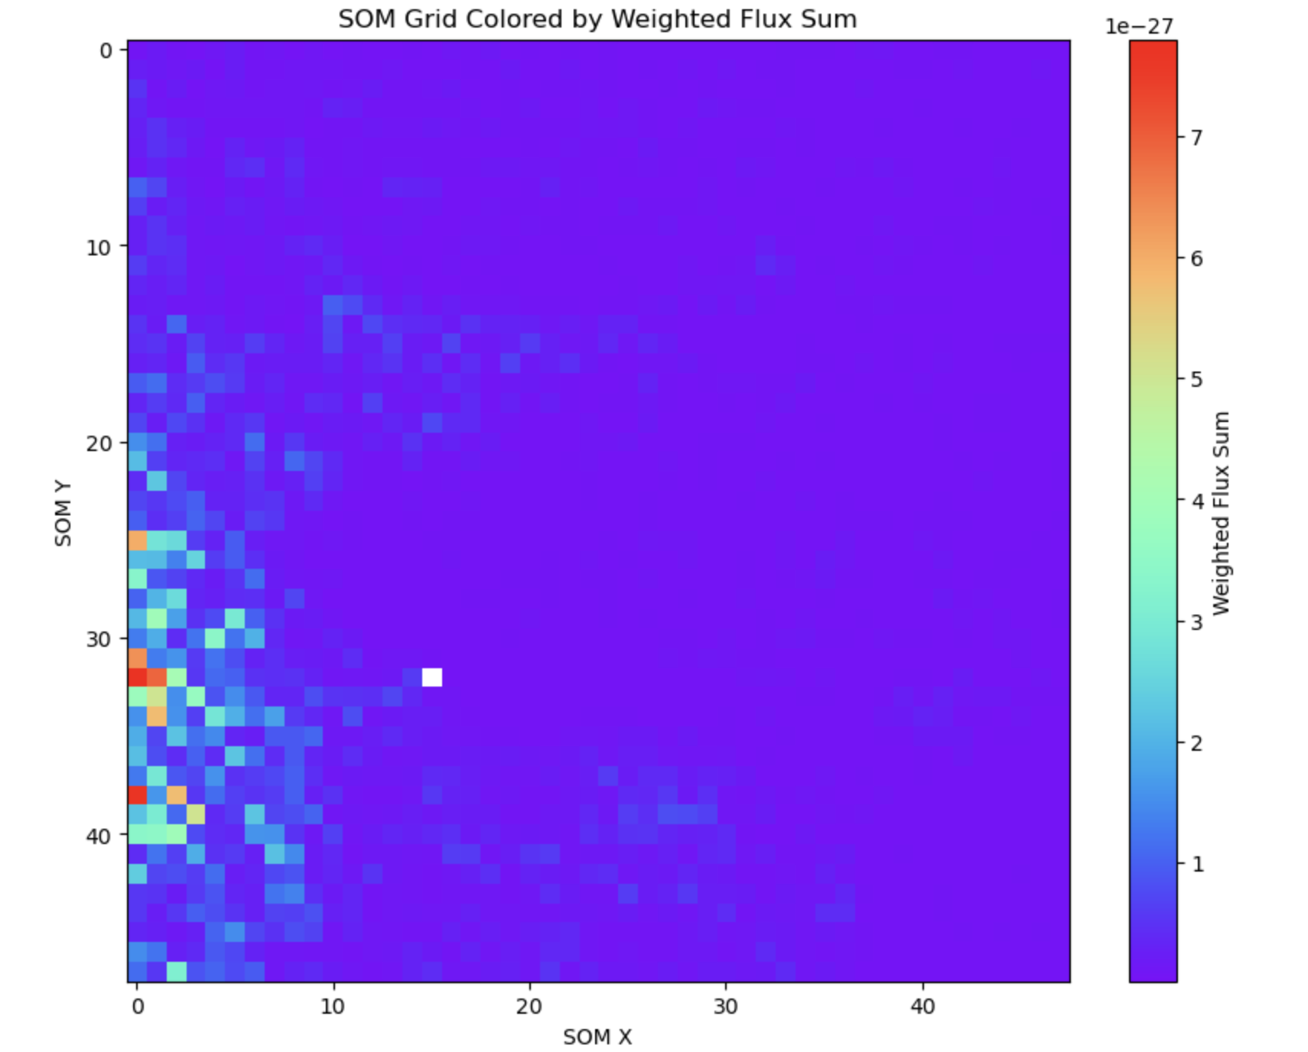
SOM - LSST (modeled with HSC ugrizy and SC z+ bands)

Slide 5
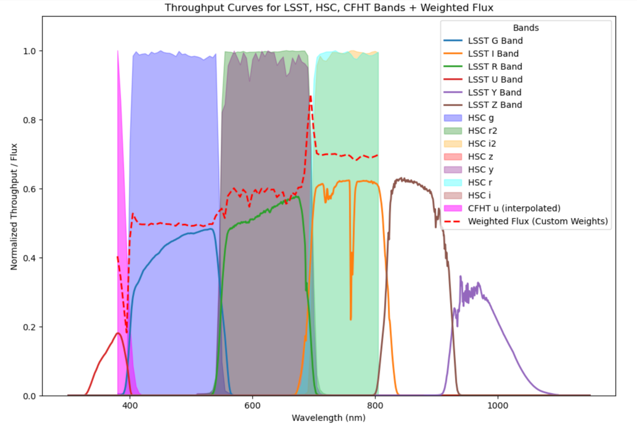
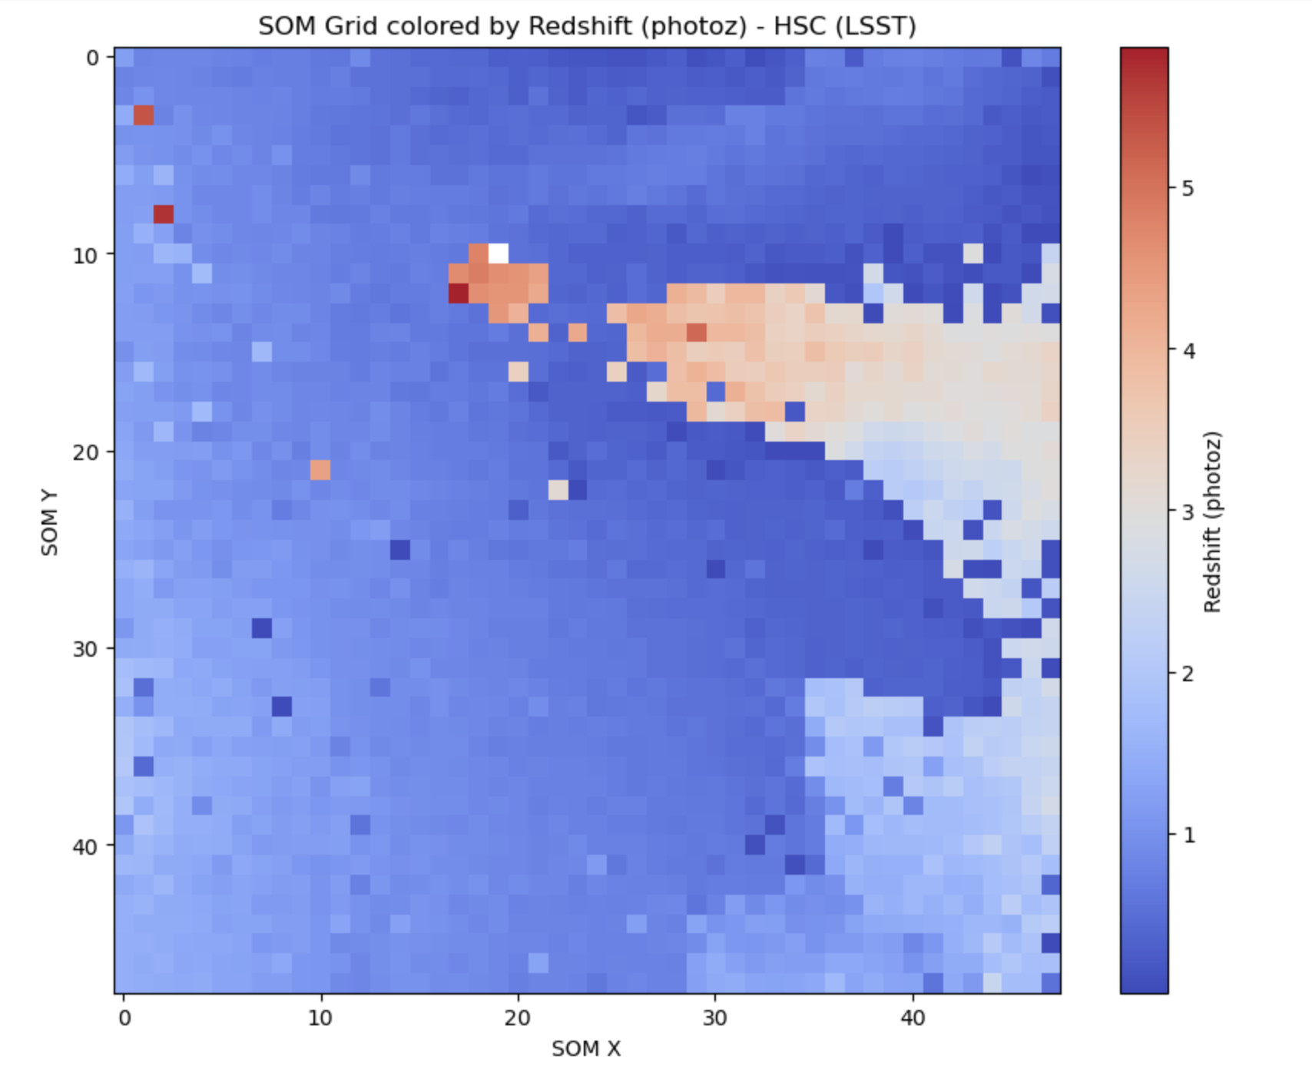
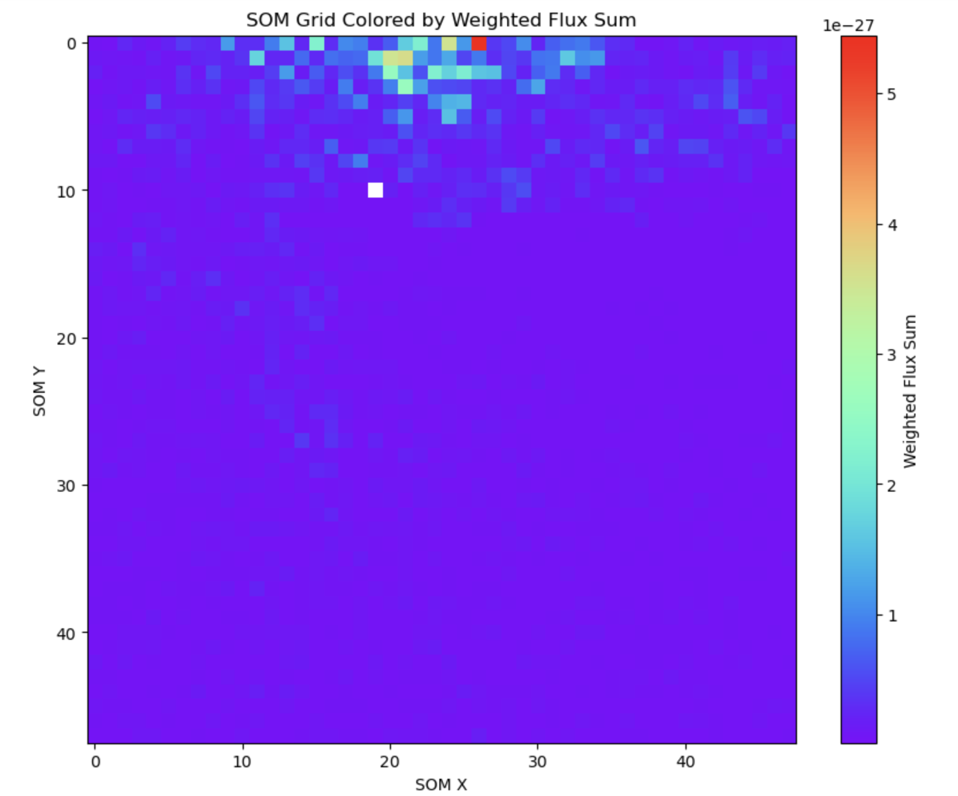
SOM - LSST (modeled with HSC ugrizy bands)

Slide 6
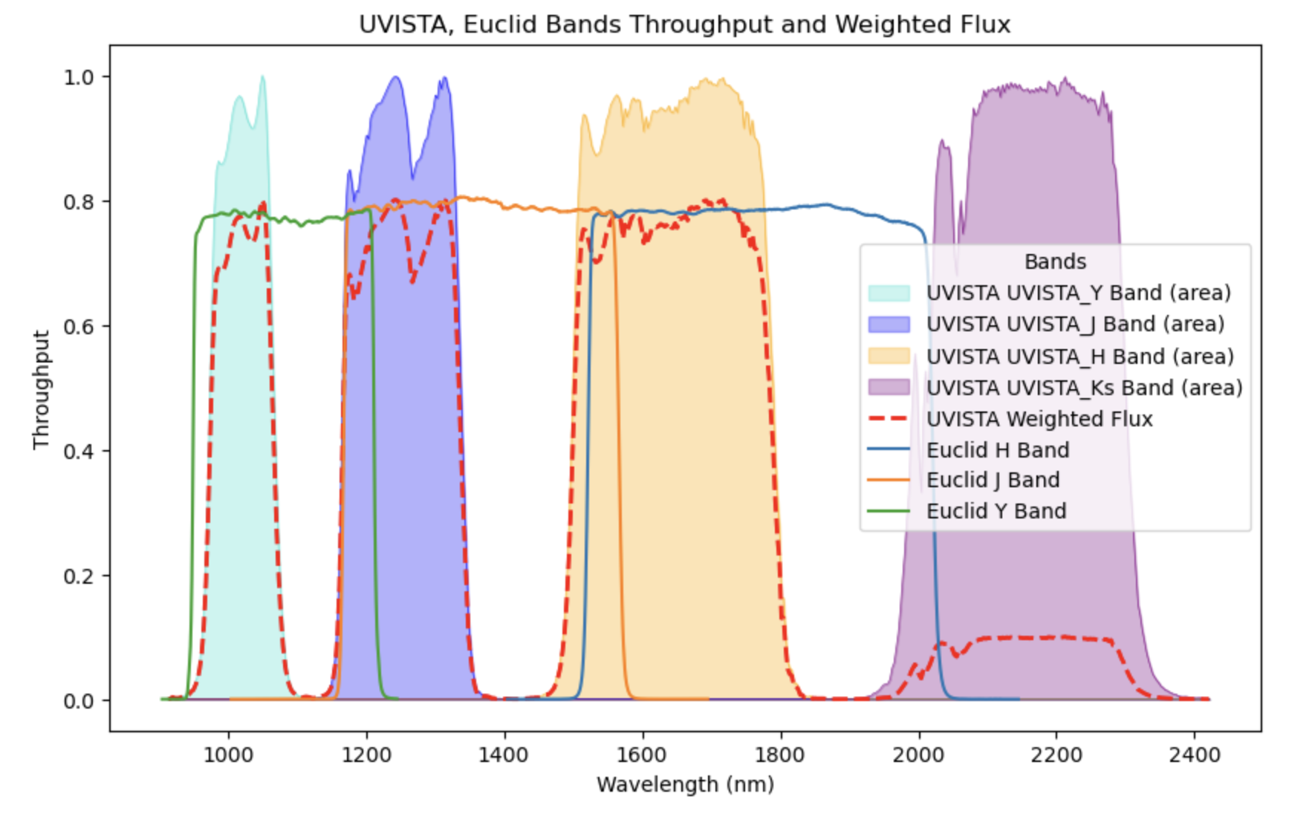
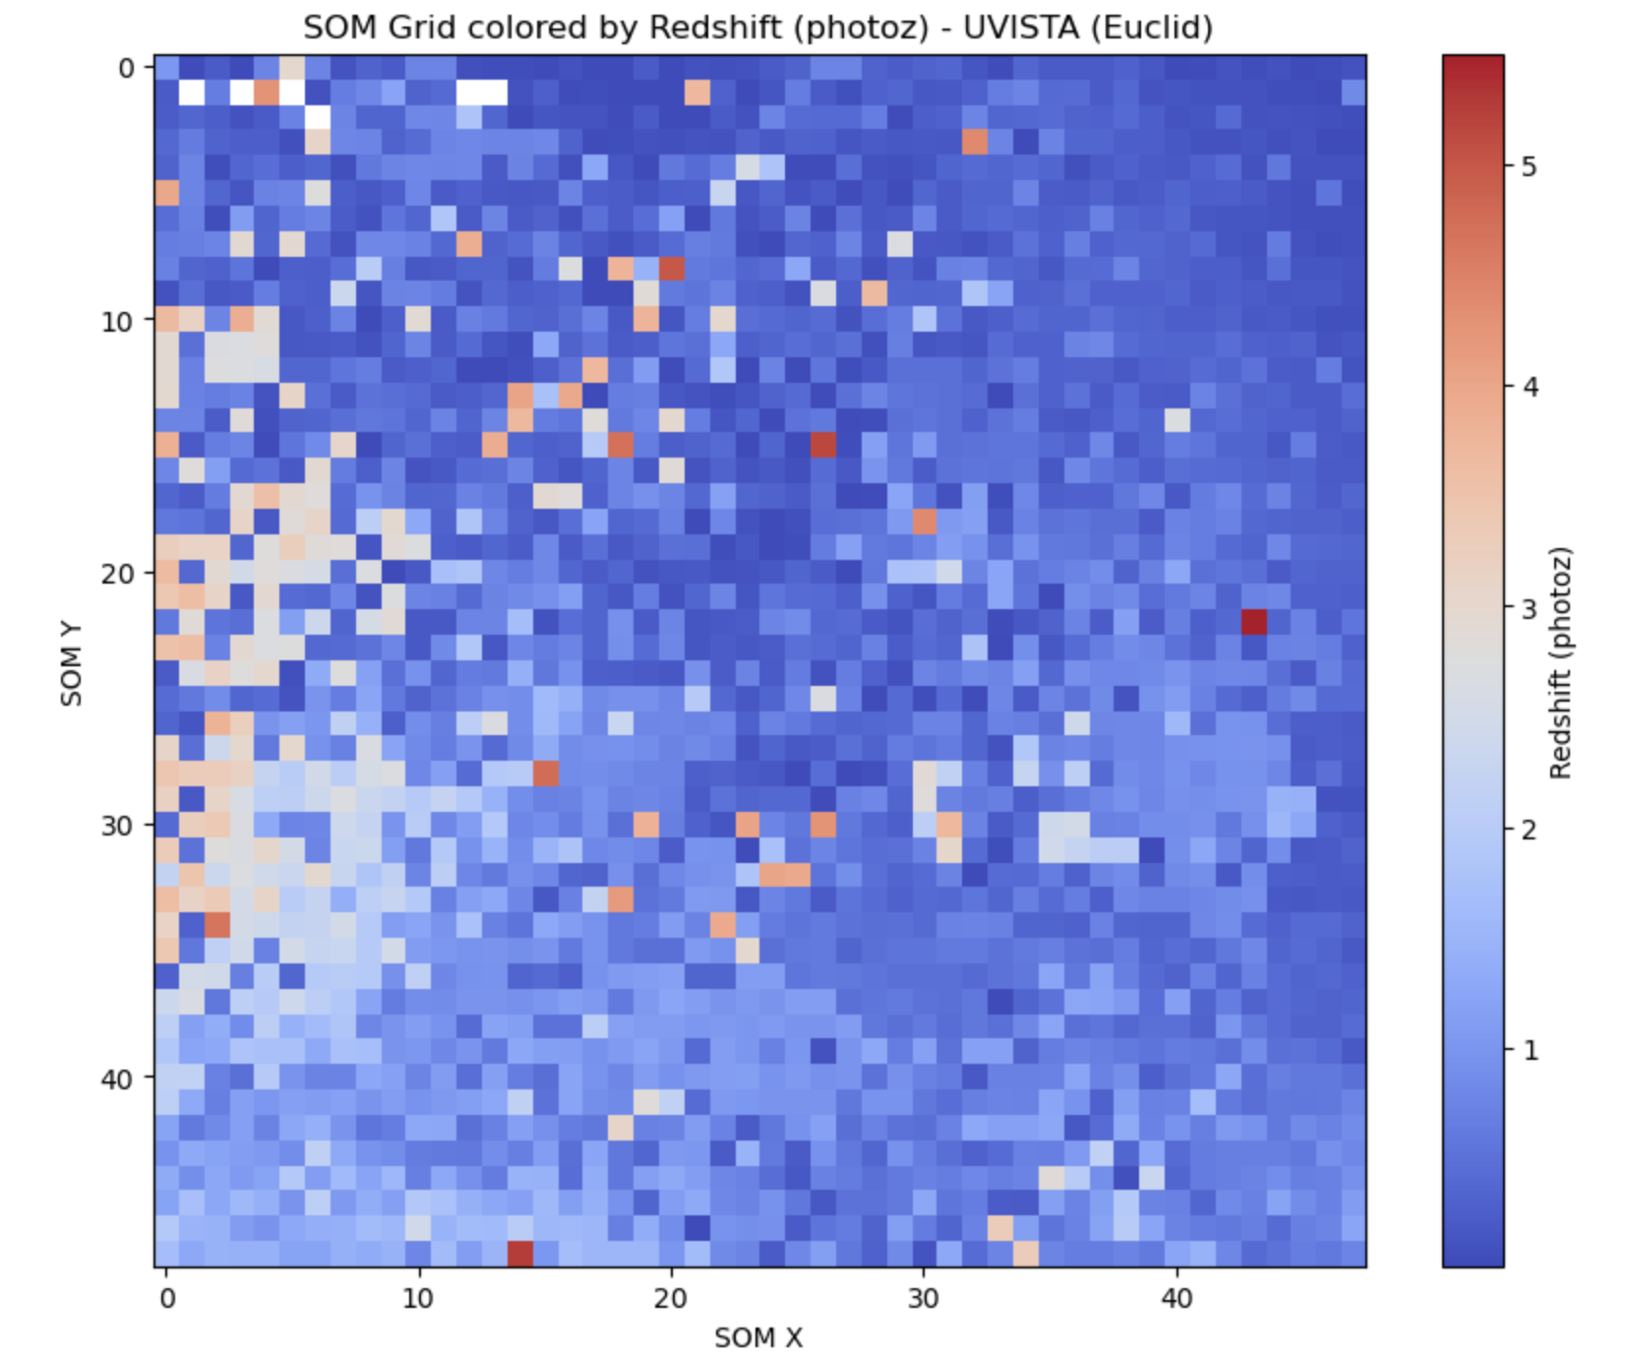
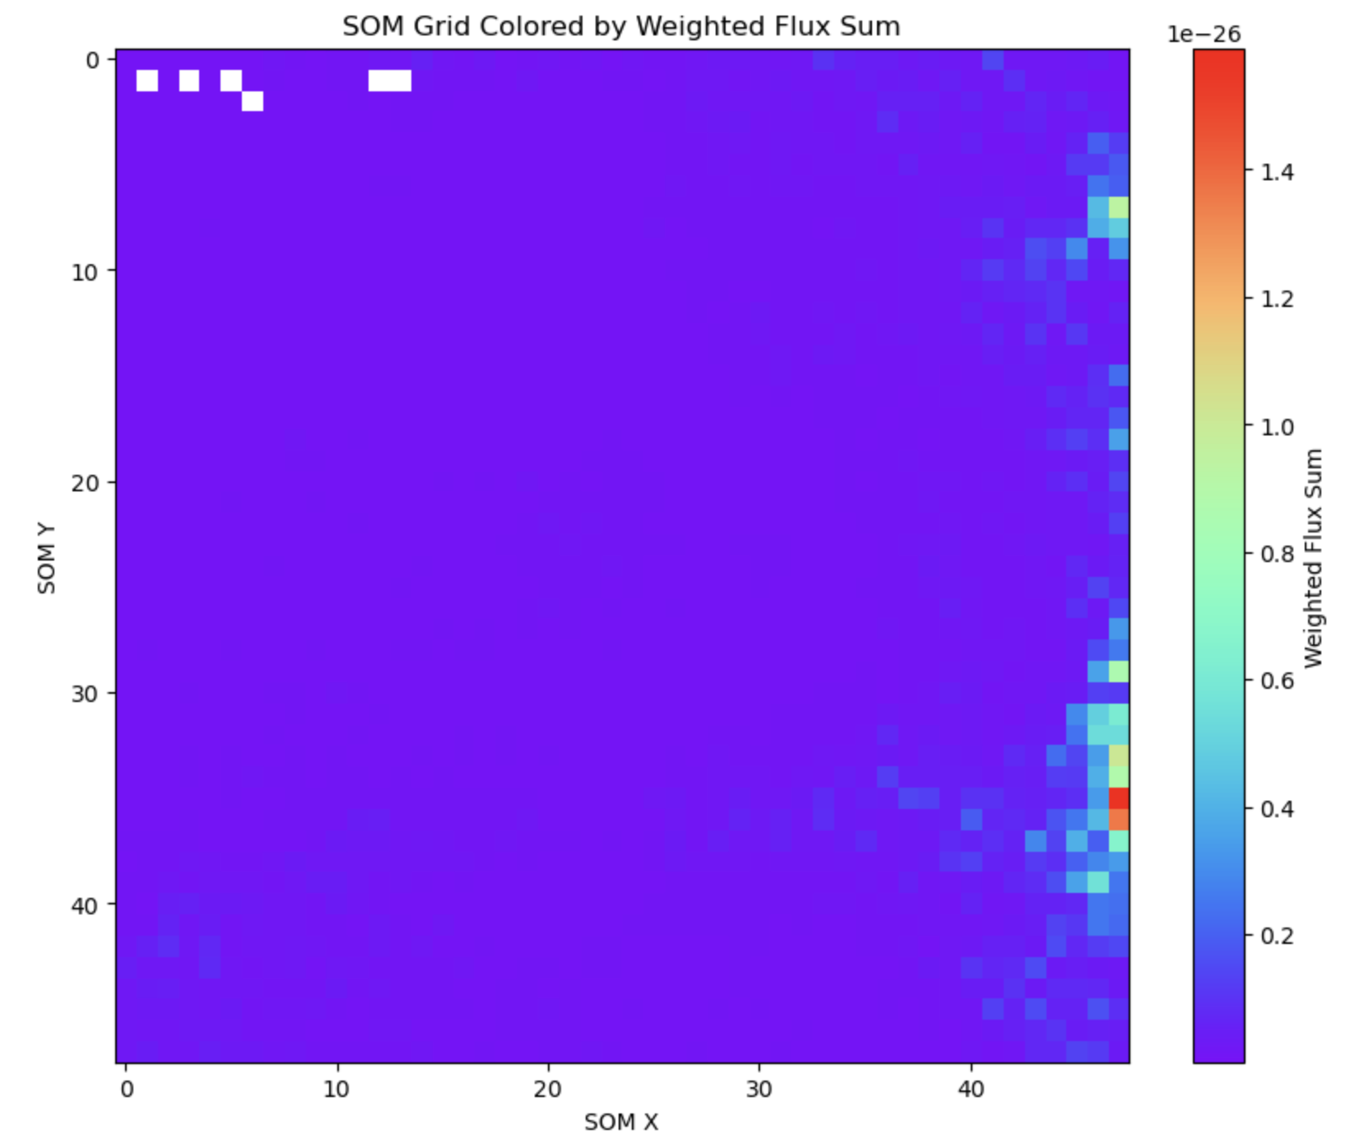
SOM - Euclid (modeled with infrared bands + riz visible light band)

Slide 7
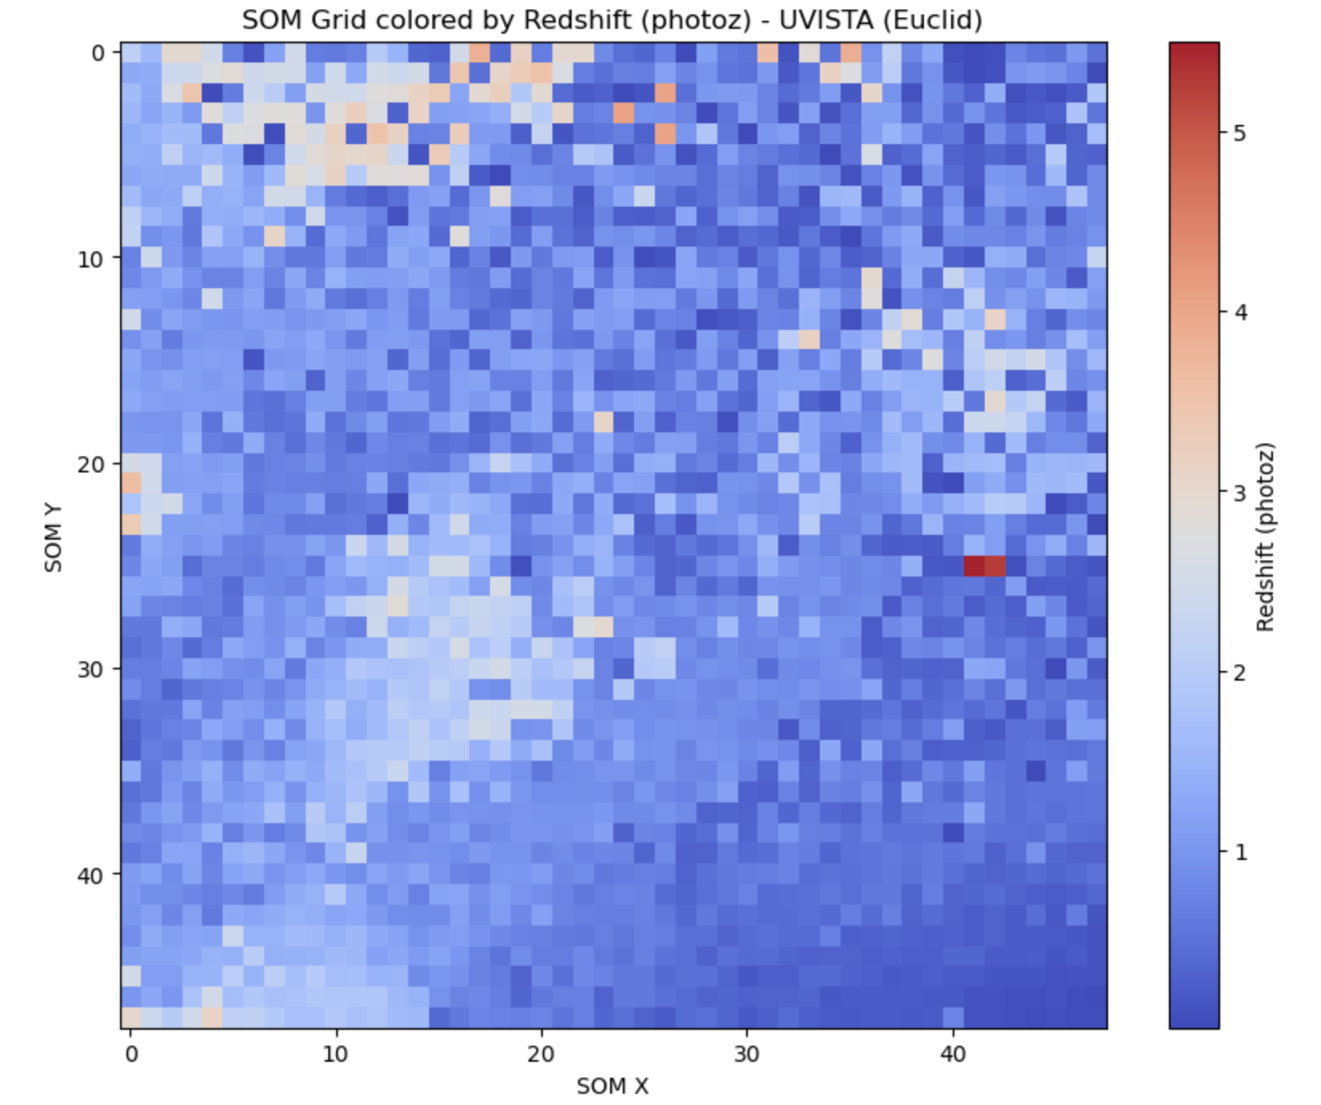
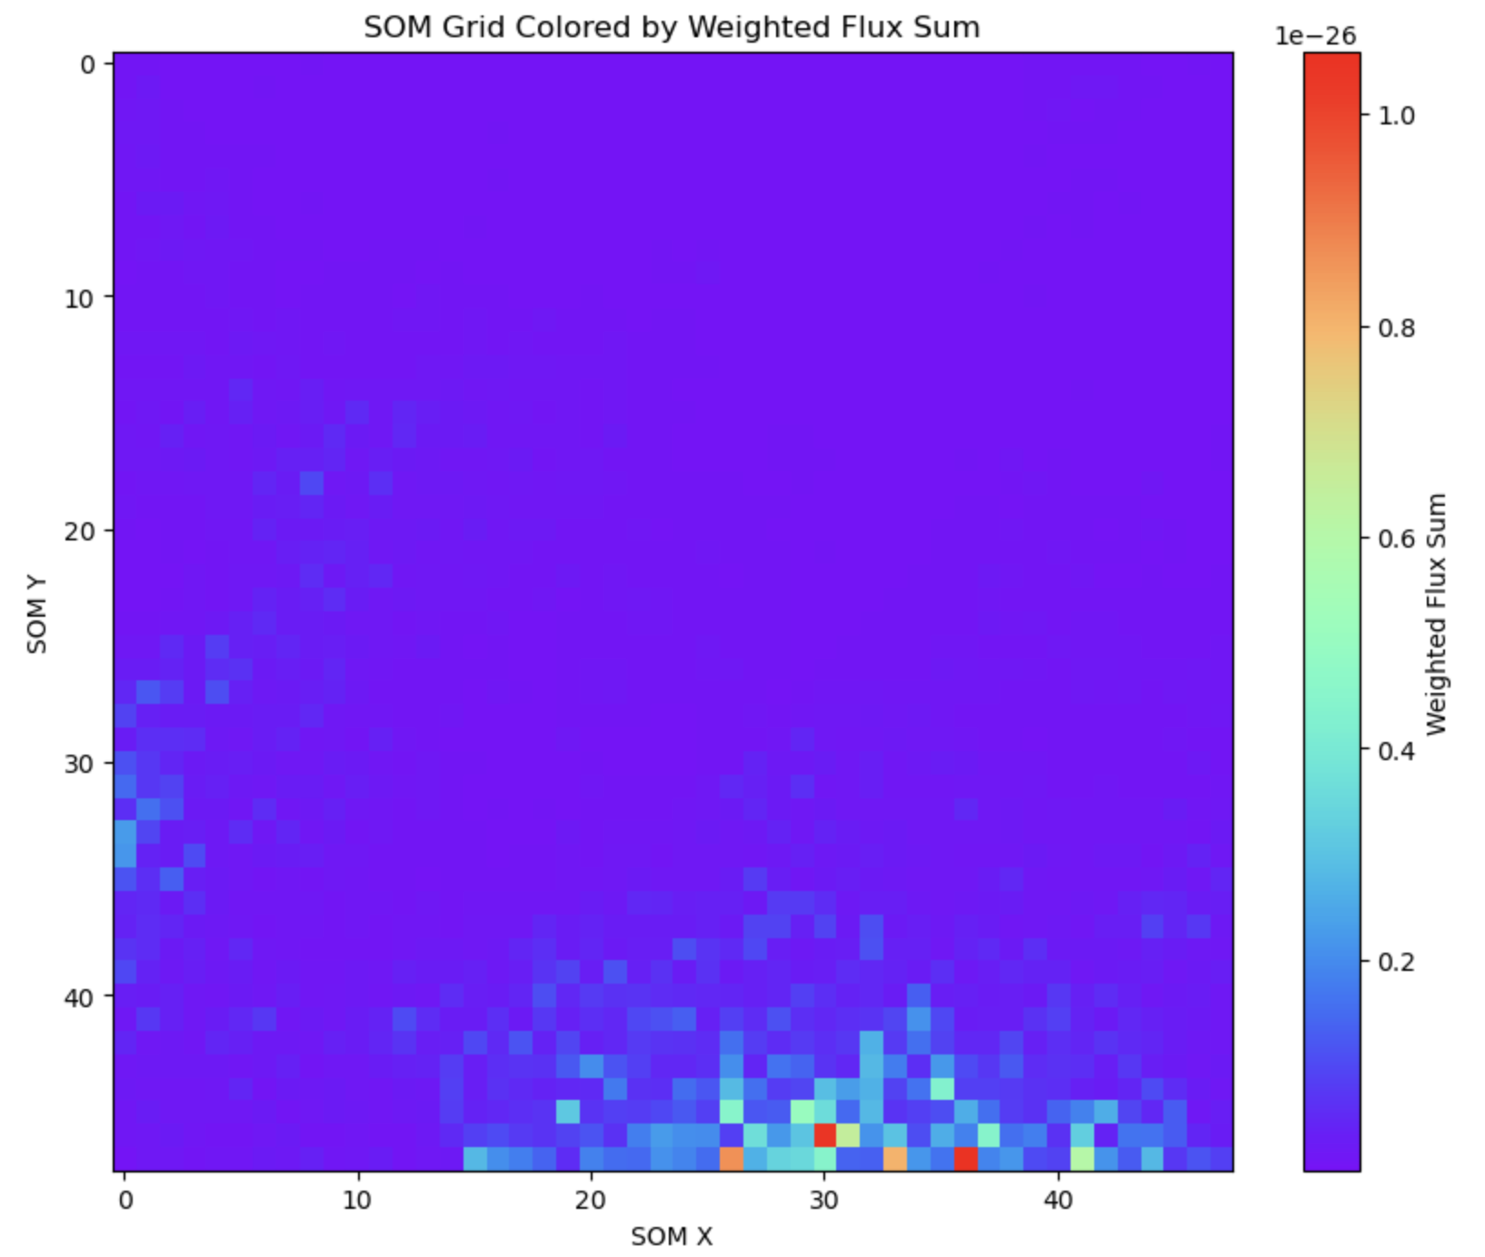
SOM - Euclid (modeled with infrared bands only)

Slide 8
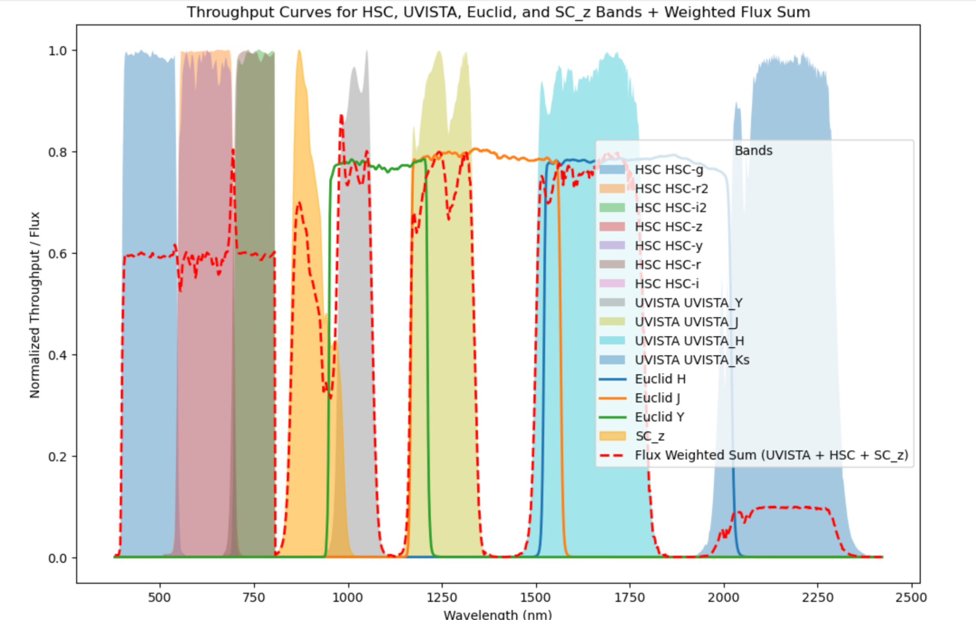
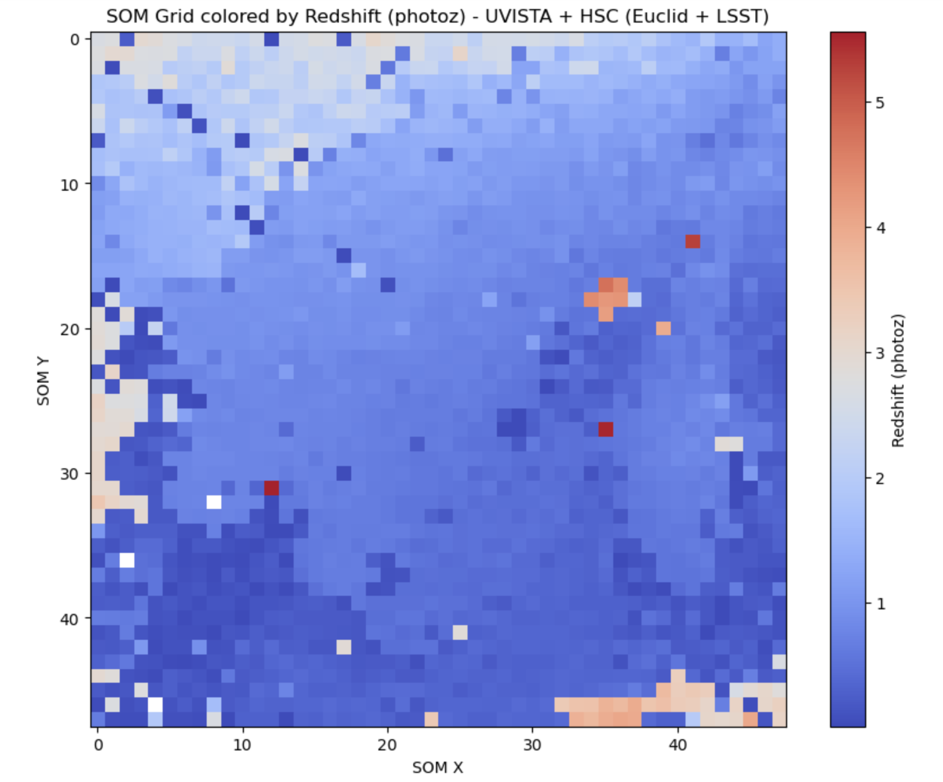
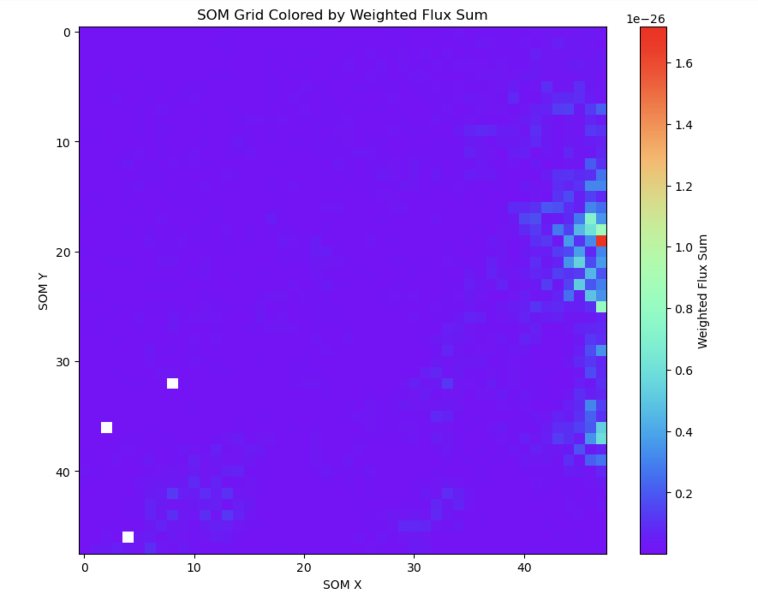
SOM - Euclid + LSST (HSC ugrizy, SC z+, UVISTA bands)

